Slide 1

Los Angeles 2016-2018 Crime vs POVERTY
“Who
Run
the
world?”
project
Are there any crime trends?
Does poverty influence crime?

Slide 2





Who run the world? Team
Ana Davalos
Diana Chacon
Evgeniya Grigoreva
Frances Gliane
Mary Basco

Slide 3

Story
Trends
People living in households in the US that have an income level below the Federal poverty threshold have more than double the rates of violent victimization compared to individuals in high-income households.
Urban poverty increased the risks of violence and crime for US households.
L.A.'s crime rise is no surprise. Los Angeles is one of the biggest cities in the US with one of the highest poverty rates in California. Poor areas precipitate more crime.
"Poverty is the parent of crime." -Aristotle

Slide 4
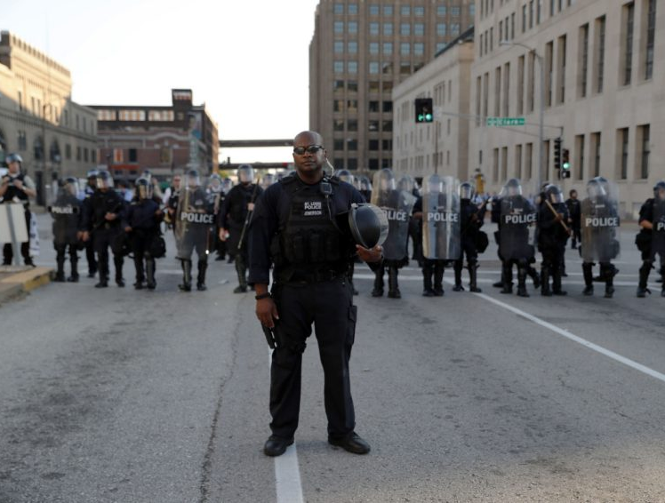
CORE HYPOTHESIS for our project
All crime categories increase over time at the same scale
The major number of criminal activities are found in underprivileged areas

Slide 5



Resources
Great Data to find great answers
Crime Data LA from 2010 to Present
Census Data
http://census.gov
Google Maps
API Docs for GMaps

Slide 6

Crime Data

Slide 7

CRIME DATA
Analysis steps
Results
Find a *.csv source file with Crime Data from 2010 to Present
Identify the crime categories listed on the dataset and combine them into 5
Crime Data from 2010 to Present
141 crime categories > 5 categories:
ASSAULT
CRIMINAL THREATS
OTHER
SEX CRIMES
THEFT

Slide 8
CRIME DATA
Analysis steps
Results
Find a *.csv source file with Crime Data from 2010 to Present
Identify the crime categories listed on the dataset and combine them into 5
Select last 3 years (2016-2018) because of the highest rates
Crime Data from 2010 to Present
141 crime categories → 5 categories:
ASSAULT
CRIMINAL THREATS
OTHER
SEX CRIMES
THEFT

Slide 9
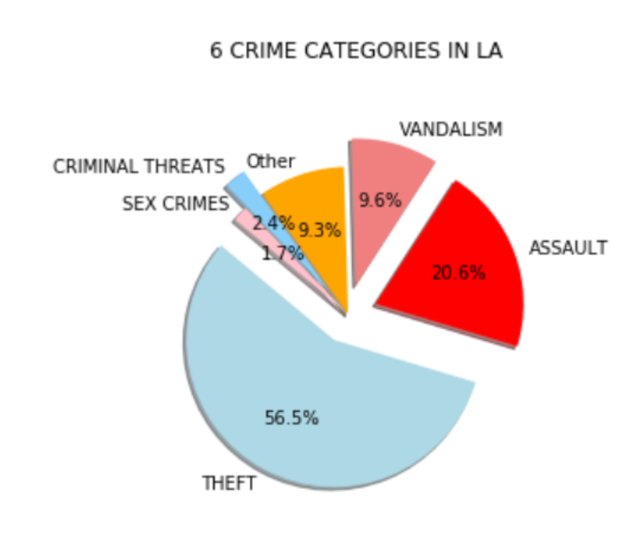
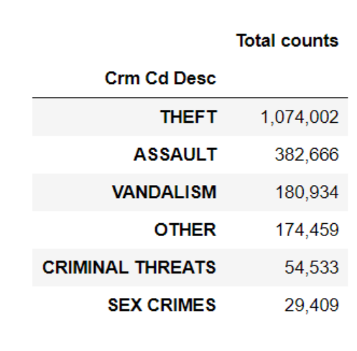
Analysis Steps

Slide 10
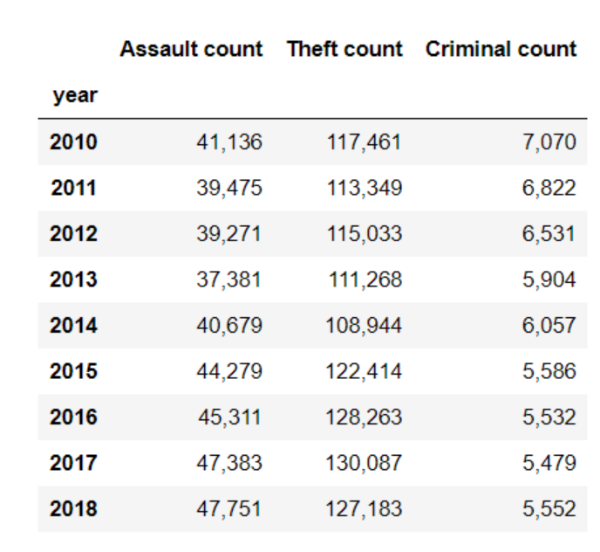
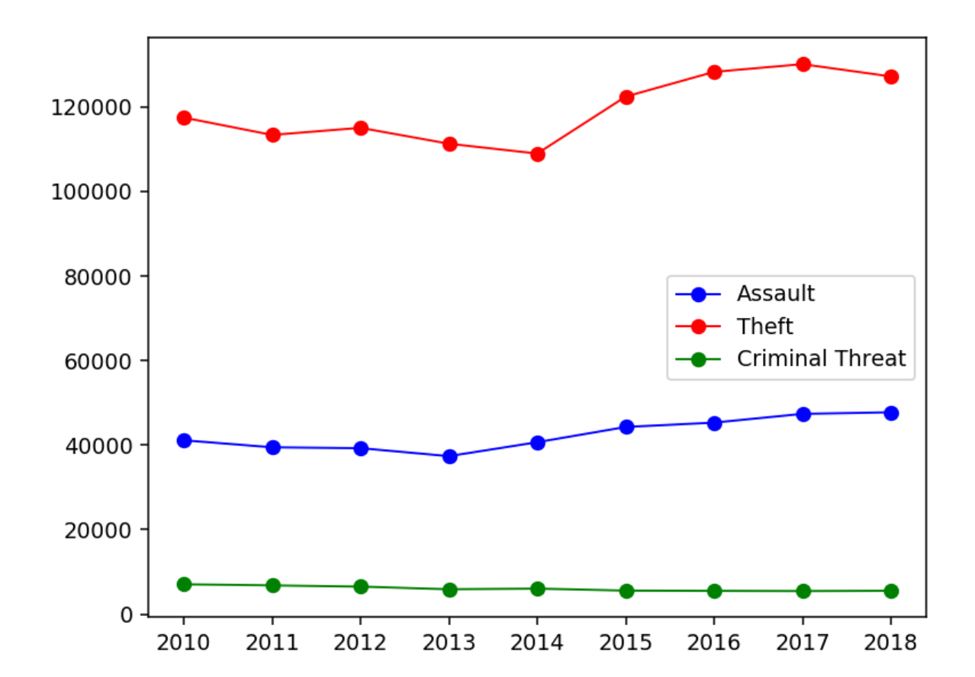
Analysis Steps

Slide 11
Sample of years
2018
2017
2016

Slide 12
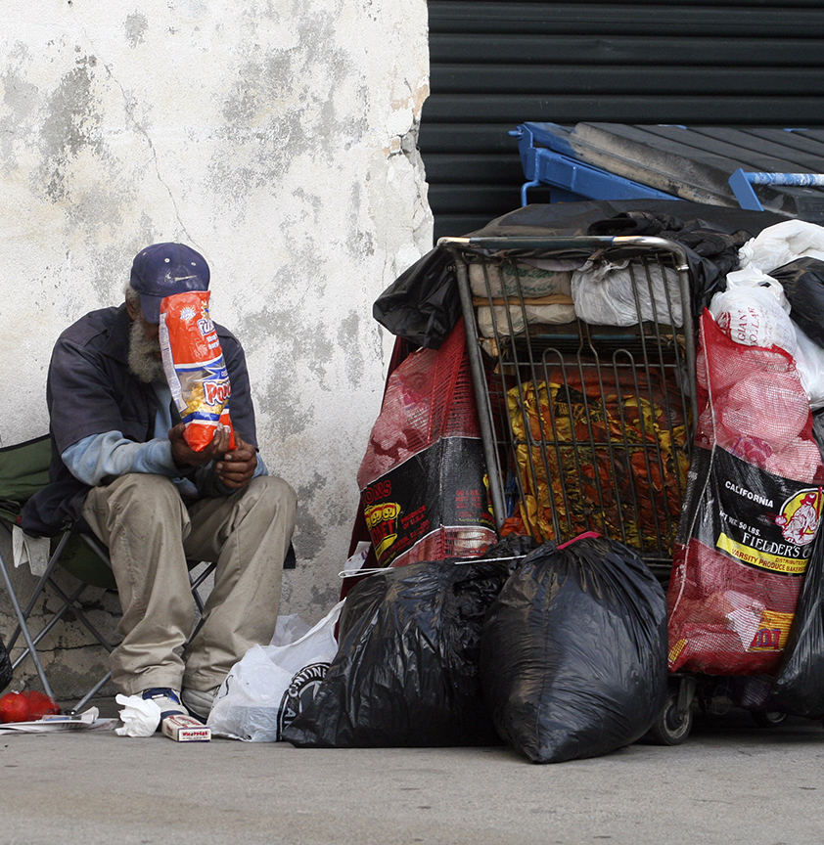
CENSUS Data
FROM Census to POVERTY RATE

Slide 13
CENSUS DATA
Analysis steps
Results
Find a *.csv source file with Census Data
Select 3 years (2016-2018) (correlation with Crime Data)
Determine a Poverty Rate
Find LA zip codes
Convert LA zip codes to Latitude, Longitude coordinates
Create a heatmap in Gmaps
Poverty Rates for different cities in the US
95 zip codes
62 final zip codes with Poverty Rates
Heatmap in Gmaps
Pip install New library PGEOCODE

Slide 14
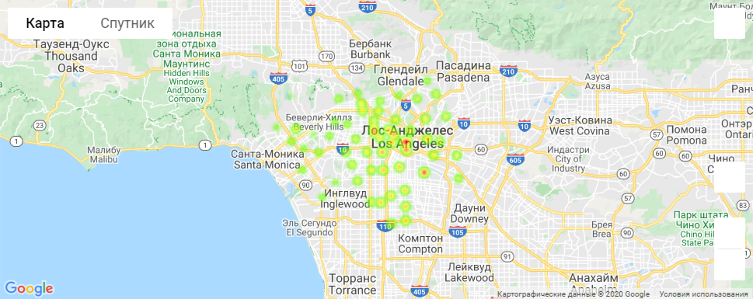
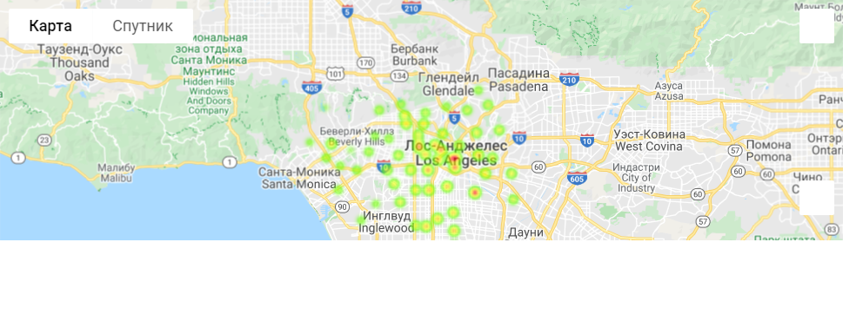
Heatmap for 2016-2018 years
2018
2017
2016

Slide 15
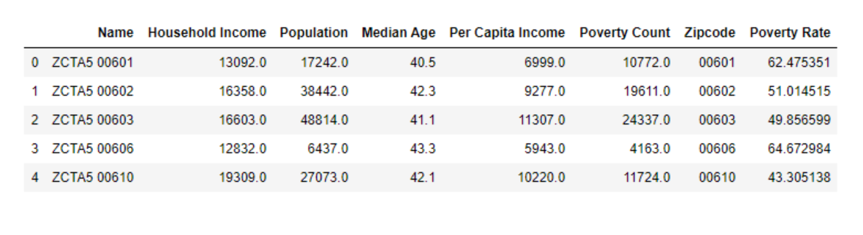
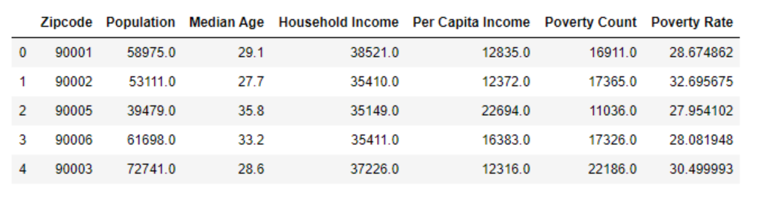
Analysis Steps

Slide 16
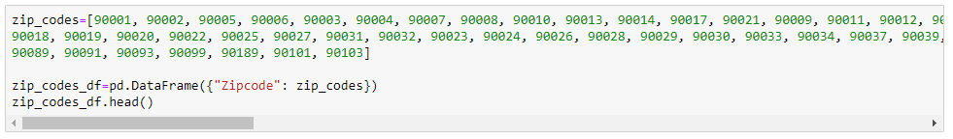
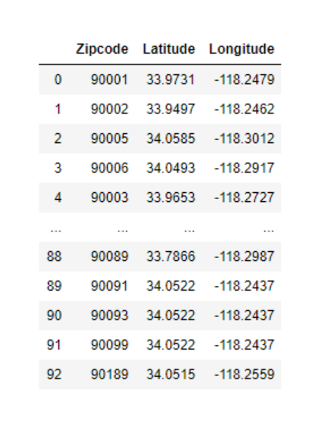
Analysis Steps
Pip install New library PGEOCODE

Slide 17
Conclusion
Vandalism and Assault categories have similar trends compare to Theft category which is exponentially increased from 108944 in 2014 to 130087 in 2017
Don’t live in LA!

Slide 18


Questions?
Who Run The World Project Team
https://github.com/dcchacon/WhoRunTheWorldProject

